Slide 1
APPLIED PHSICS
(SEAP-113)

Slide 2
Voltage
Voltage describes the “pressure” from an electrical circuit's power source that pushes charged electrons (current) through a conducting loop, enabling them to do work such as illuminating a light.
Unit known as the volt (V).
Higher voltages cause more electric current to flow to an electronic device.
The term recognizes Italian physicist Alessandro Volta (1745-1827), inventor of the voltaic pile—the forerunner of today's household battery.
In electricity's early days, voltage was known as electromotive force (emf). This is why in equations such as Ohm's Law, voltage is represented by the symbol E.

Slide 3

Current
An electric current is a stream of moving charges.
However, not all moving charges constitute an electric current.
To have that, here must be a net flow of charge through a surface.
Consider a flow of water through a garden hose.
Unit: Ampere (Normally in milli-Amperes)

Slide 4
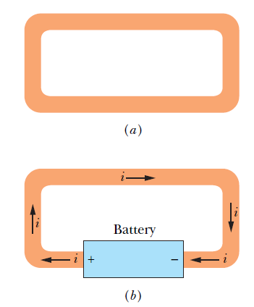
Electric Current
The free electrons (conduction electrons) in an isolated length of copper wire are in random motion at speeds of the order of 10⁶ m/s. If you pass a hypothetical plane through such a wire, conduction electrons pass through it in both directions at the rate of many billions per second—but there is no net transport of charge and thus no current through the wire.
However, if you connect the ends of the wire to a battery, you slightly bias the flow in one direction, with the result that there now is a net transport of charge and thus an electric current through the wire.

Slide 5
Conventional vs Electronic Current
The main difference between the conventional current and electric current is the direction of flow of charges changes. In conventional current it is from positive to negative terminal whereas it is negative to positive terminal in electric current.
Electronic Current is the real and actual direction of electric current.
Conventional Current is assumption to solve and analyze electric circuits easily.

Slide 6
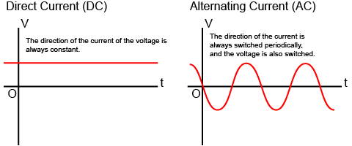
Difference between AC and DC
Electric Current flows in two ways as an Alternating Current (AC) or direct current (DC).
The main difference between AC and DC lies in the direction in which the electrons flow. In DC current, the electrons flow steadily in a single direction. In AC current, electrons keep switching directions, going forward and then backwards.
In DC, voltage is always constant. The polarity of the terminals do not change (remain fixed) and the electricity flows in a certain direction. In AC, the voltage periodically changes from positive to negative and from negative to positive, and the direction of the current also periodically changes accordingly.

Slide 7

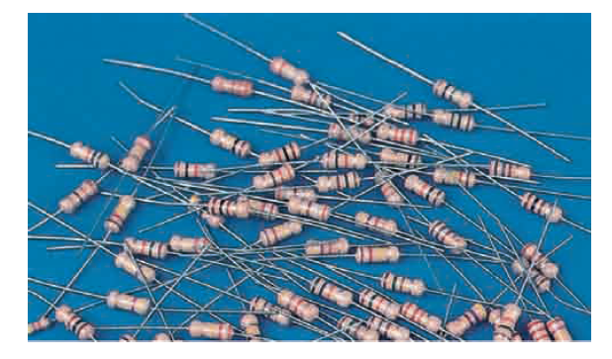

Resistance
Resistance is a measure of the opposition to current flow in an electrical circuit
Symbol of resistance is “R”
Unit of Resistance is Ohm and can be described as when a constant potential difference of one volt, applied to two points, produces in the conductor a current of one ampere
Symbol

Slide 8


Resistivity & Conductivity
Resistivity is a property that describes the extent to which a material opposes the flow of electric current through it. It is a property of the material itself (not the size or shape of the sample), usually depends on temperature and may depend on other quantities such as pressure.
The resistance of a piece of material depends on its resistivity and also its size and shape. The resistance R of a wire with cross sectional area A and length L (Figure 1), made from a material of resistivity ρ ('rho'), is given by the equation
The unit of resistivity is the Ωm (ohm metre).
Electrical conductivity σ ('sigma') is the reciprocal of resistivity and can be written as
The unit of conductivity is the Sm⁻¹ (siemens per metre).

Slide 9
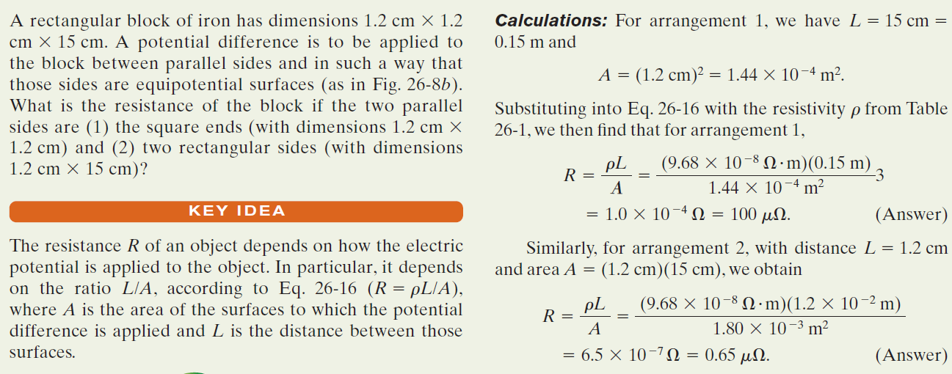
Example - A material has resistivity, a block of the material has a resistance.

Slide 10
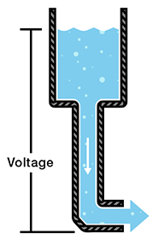
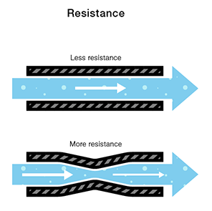
Concepts of Electricity contd.
All these three principles are well explained via water tank philosophy

Slide 11

Relation b/w Voltage, Current and Resistance

Slide 12
Ohm’s Law

Slide 13
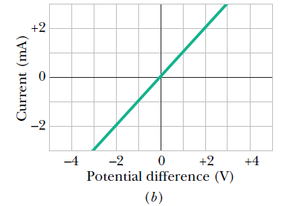

Ohm’s Law
Ohm’s Law establishes a relationship between voltage and current through a resistance.
Ohm’s law states that the voltage across a conductor is directly proportional to the current flowing through it, provided all physical conditions and temperatures remain constant.
This relationship established as
$V=I×R$ I = $\frac{V}{R}$ R = $\frac{V}{I}$
This is a linear equation means the plot between voltage and current will be a straight line when resistance is constant.

Slide 14

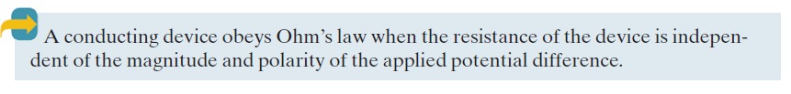
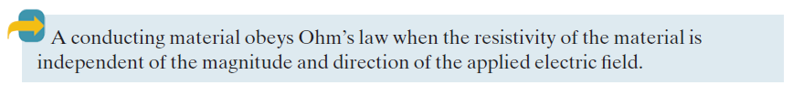
Ohm’s Law contd.

Slide 15
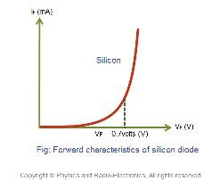
Ohm’s Law contd.
Ohm’s law only holds true if the provided temperature and the other physical factors remain constant.
In certain components, increasing the current raises the temperature. An example of this is the filament of a light bulb, in which the temperature rises as the current is increased. In this case, Ohm’s law cannot be applied. The lightbulb filament violates Ohm’s Law.
Another examples are Semiconductor materials (Diode and Transistors) as their I-V characteristics is a curved line instead of straight line.
Ohmic and Non-ohmic Devices

Slide 16

Ohm’s Law contd.
Electrical Power (P) in a circuit is the rate at which energy is absorbed or produced within a circuit
A source of energy such as a voltage will produce or deliver power while the connected load absorbs it
Mathematically we can write Power as
$$P=V×I$$
The Units of Power is Watt (W), milliwatt (mW) or kilowatt (KW) is also use extensively in electronics and electrical circuits

Slide 17
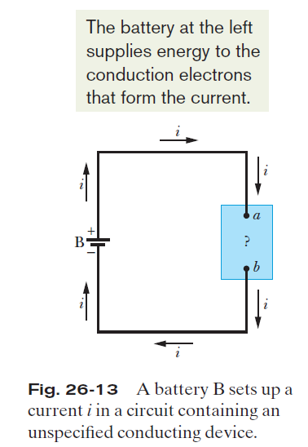




Power Dissipation
The unit of power is the volt-ampere (V A).

Slide 18
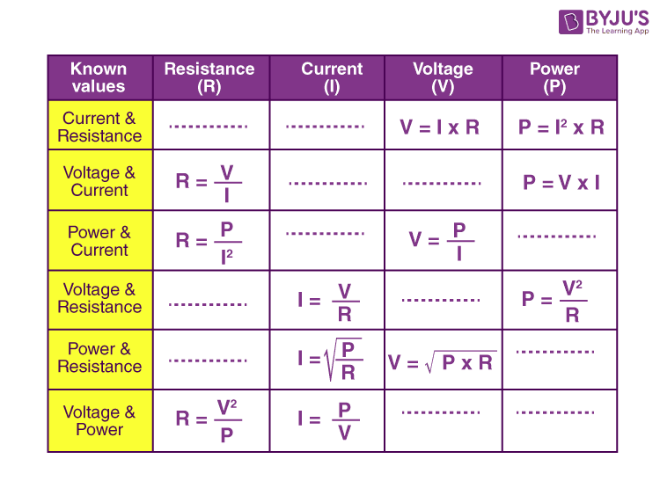
Ohm’s Law contd.

Slide 19
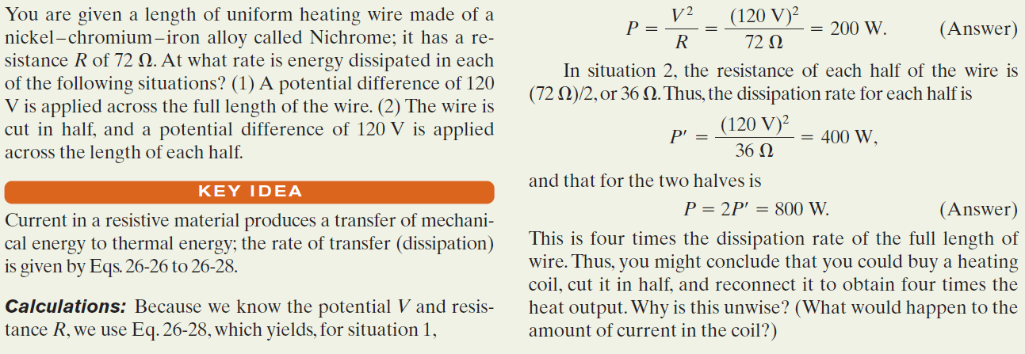
Example, Rate of Energy Dissipation in a Wire Carrying Current:

Slide 20
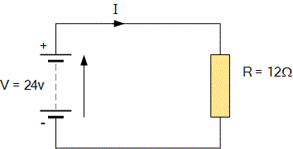
Ohm’s Law contd.
For the circuit shown below find the Voltage (V), the Current (I), the Resistance (R) and the Power (P)

Slide 21
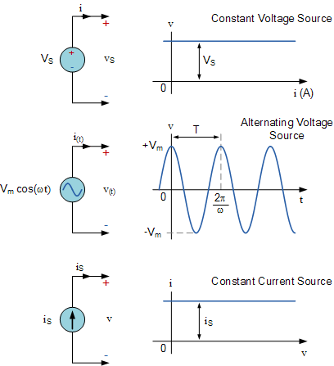
Voltage and Current Sources

Slide 22
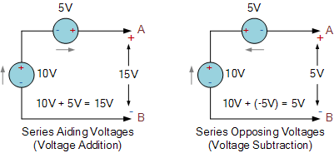
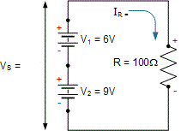
Voltage and Current Sources contd.

Slide 23
Series & Parallel Combination of Resistors

Slide 24
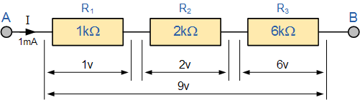
Series Combination of Resistors
Resistors are said to be connected in “Series”, when they are daisy chained together in a single line.
Resistors in series has common current flowing through them.
Voltage divide according to the Resistors’ values
Higher the resistance value, more voltage drop across it

Slide 25
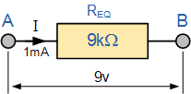

Series Combination of Resistors Contd.
The amount of current will remain same throughout the network
$$I_{T}=I_{R1}=I_{R2}=I_{R3}$$
The equivalent resistance is the sum of all the resistance
$$R_{T}=R_{1}+R_{2}+R_{3}$$
The total resistance ( R_{T} ) of any two or more resistors connected together in series will always be GREATER than the value of the largest value resistor in the chain.

Slide 26
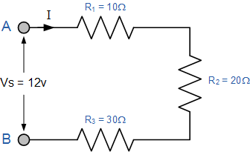
Series Combination of Resistors Contd.
A simple example for calculating the total resistance and current

Slide 27
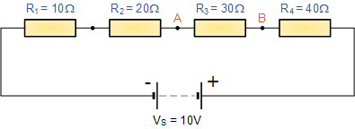
Series Combination of Resistors Contd.
Another example for finding the voltage between two points

Slide 28
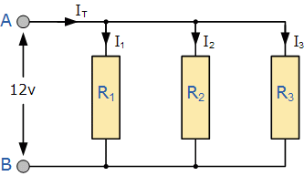
Parallel Combination of Resistors
Resistors are in parallel if their terminals are connected to the same two nodes.
In a parallel resistor network, the circuit current can take more than one path as there are multiple paths for the current.
Resistors in Parallel have a Common Voltage across them but current will divide (depends upon the resistance value)

Slide 29
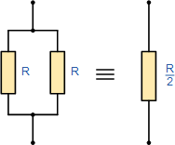

Parallel Combination of Resistors Contd.
The amount of voltage will remain same throughout the network
$$V_{T}=V_{R1}=V_{R2}=V_{R3}$$
The equivalent resistance can be calculated as follows
$$\frac{1}{R_{T}}=\frac{1}{R_{1}}+\frac{1}{R_{2}}+\frac{1}{R_{3}}$$
The total resistance ( R_{T} ) of any two or more resistors connected together in parallel will always be Lesser than the value of the smallest value resistor in the combination.

Slide 30
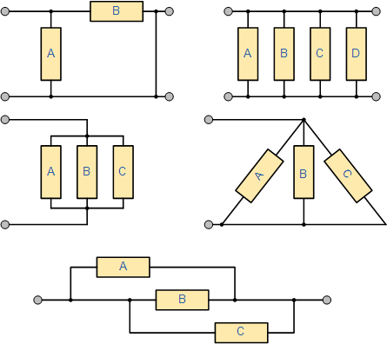
Some Combinations of Resistors

Slide 31
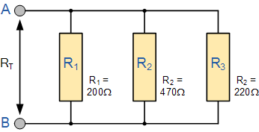
Parallel Combination of Resistors Contd.
An example for parallel network

Slide 32
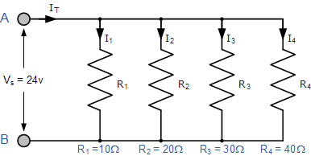
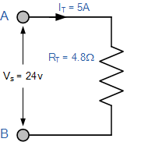
Parallel Combination of Resistors Contd.
Another example

